Slide 1
Introduction to InSpec
Notes:
This Chef Compliance course provides an understanding of the capabilities of Chef Compliance. This course covers how to install and initially configure the Chef Compliance server, perform compliance scans against Windows and Linux nodes, and remediate compliance issues with Chef, and run Compliance reports.
In addition, you will learn how to use InSpec to create and modify Chef Compliance profiles and learn how to locate CIS (Center for Internet Security) and DoD (Department of Defense) compliance specifications that you can use to write Chef Compliance profiles.
Instructor Note: Be sure to read Appendix Z at the end of this instructor guide for training lab set up notes and additional instructor notes. Instructor Note: This course has been tested on Compliance Server v1.2.4. The labs have been tested against target Linux and Windows nodes that have ChefDK 0.11.2 and inspec 0.14.7. You must use at least inspec 0.14.7 on the target nodes in order for these labs to work. That version of inspec is present on the AMIs used for this course. Update: The Linux AMI has been upgraded to inspec 0.22.1 so that CLI login to Compliance Sever will work, as documented in module 05-Creating Custom Profiles.

Slide 2
Agenda
Orientation to the learning environment
Introduction to InSpec
The InSpec Command Line Interface (CLI)
Integration testing with InSpec
Additional Resources and Support

Slide 3
Objectives
Execute an InSpec test on a local machine
Execute an InSpec test on a remote machine
Generate an InSpec profile
Add InSpec-based integration test to a Chef cookbook
Run InSpec-based integrations tests during Chef cookbook development
List additional resources and places to look for support with InSpec

Slide 4
Learning Environment
Let’s have a look around

Slide 5
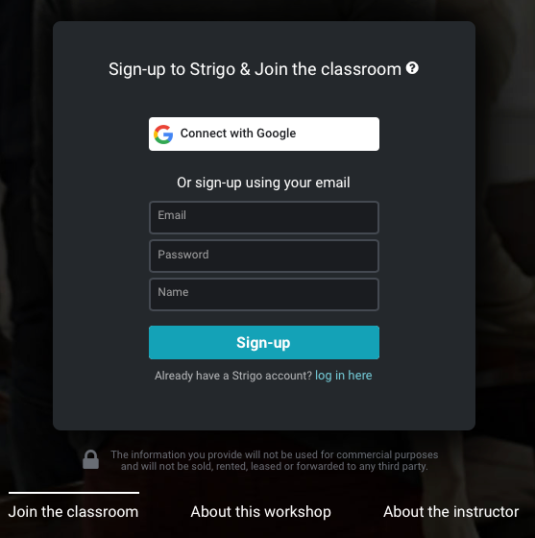
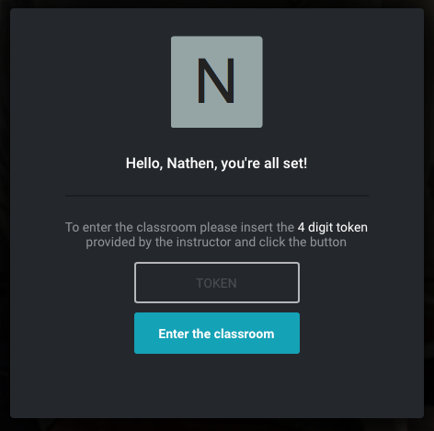

Slide 6


Slide 7
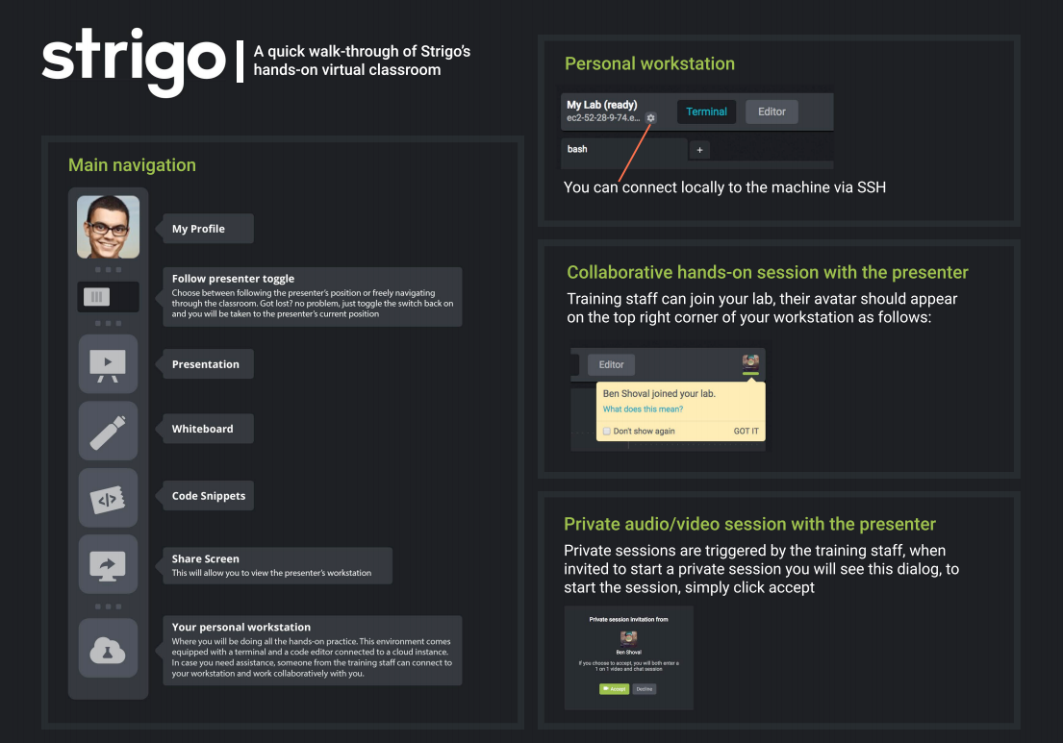

Slide 8
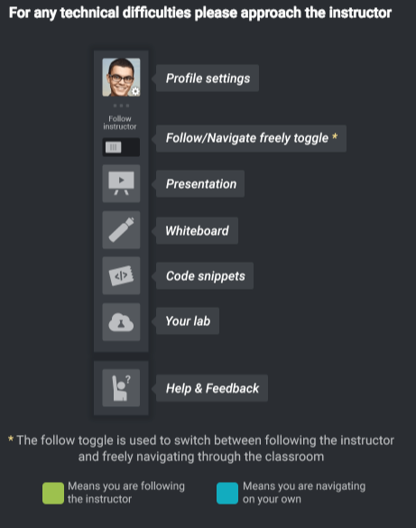
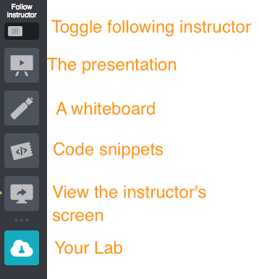

Slide 9
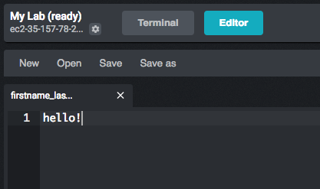
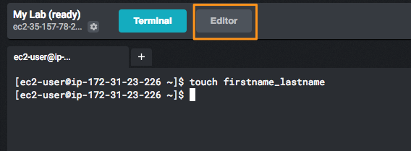

Slide 10
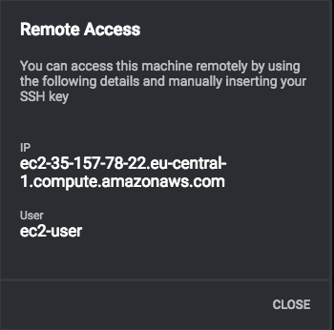
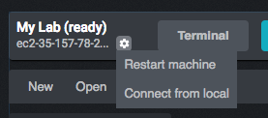
Login Directly
Login: chef
Password: chef

Slide 11
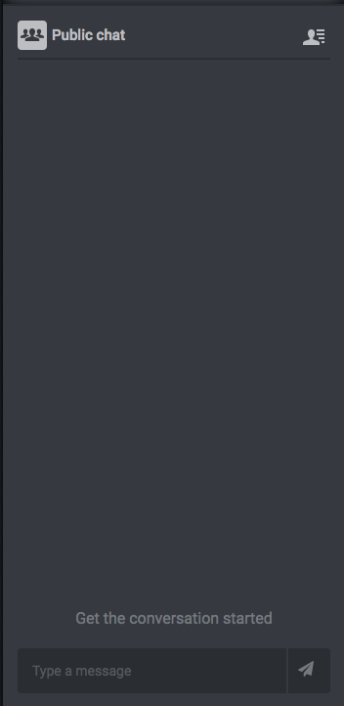
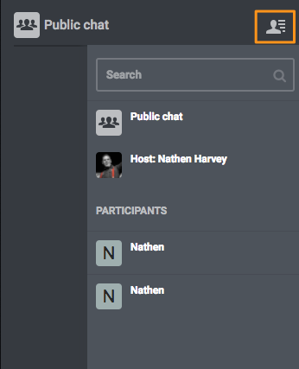

Slide 12

Join us in Slack!
Signup - http://community-slack.chef.io/
Join the channel for this class

Slide 13
Infrastructure as Code

Slide 14
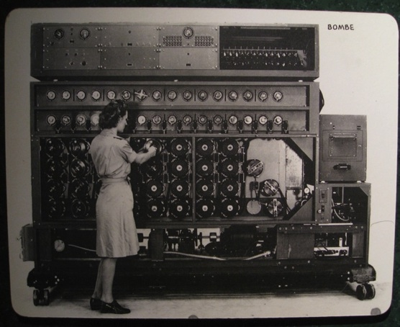
Infrastructure as Code
Programmatically provision and configure components
Treat like any other code base
Reconstruct business from code repository, data backup, and compute resources
Notes:
Automation Framework: Infrastructure becomes as versionable, testable, and repeatable as application code.
We don’t want the experience to feel like “Linux on windows”

Slide 15
Infrastructure as Code
BUILD
DEPLOY
MANAGE
Develop reusable Cookbooks
Expose tunable settings
Test locally to reduce risk, and ensure compliance
Commit to Source Code
Automated Testing through Continuous Integration
Automatically promote across environments
Easily deploy new configurations in a matter of minutes.
Continuously verify and repair misconfigured systems

Slide 16
Test-driven Development
Write a unit test, watch it fail
Write some code
Write and run more unit tests
Run some integration/acceptance tests
Code review
Delivery pipeline to production
Lowered chance of production failure
Add a test
pass
Run the tests
fail
Make a little change
pass
[development continues]
fail
Run the tests
pass
[development stops]

Slide 17
Software Testing and Why it Matters
more time
more time
manual
tests
automated
API tests
automated
GUI tests
automated unit tests
automated
integration tests
integration
tests
less time
less time
automated
GUI tests
unit
tests
manual session based tests
automated
component tests
quantity
quantity
Testing builds safety through feedback loops
Inexpensive experiments to provide validation
Reduces risk
Optimize Testing: Do more of the inexpensive testing first!

Slide 18

Remember…
Infrastructure policies need testing
↳ Linting
↳ Static Analysis
↳ Unit Testing
↳ Integration Testing ↳ Compliance Testing
“Infrastructure as Code” should be tested like ANY other codebase.

Slide 19
Integration Testing – Add tests
describe package 'httpd' do
it { should be_installed }
end
describe service 'httpd' do
it { should be_running }
it { should be_enabled }
end
describe port(80) do
it { should be_listening }
end
Add a test
pass
Run the tests
fail
Make a little change
pass
[development continues]
fail
Run the tests
pass
[development stops]

Slide 20
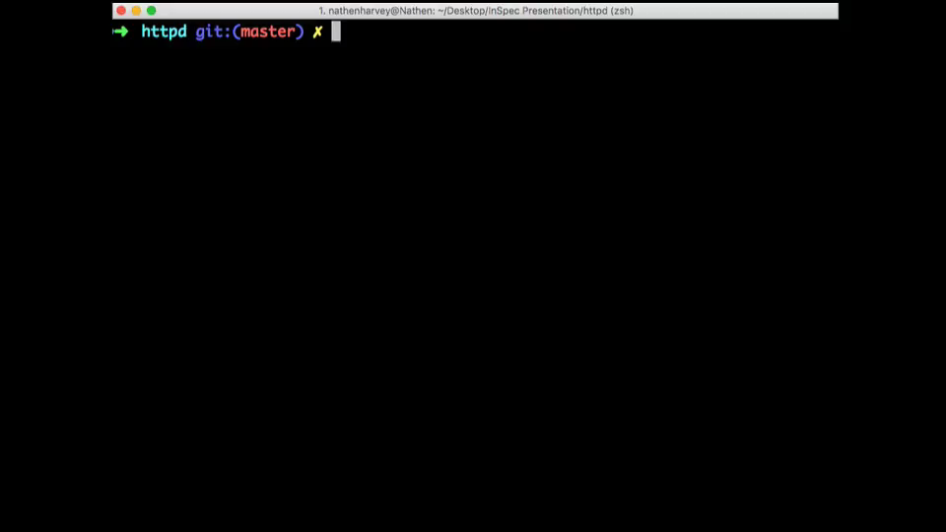
Integration Testing - Run the tests
Add a test
pass
Run the tests
fail
Make a little change
pass
[development continues]
fail
Run the tests
pass
[development stops]
Notes:
Auto-playing video

Slide 21
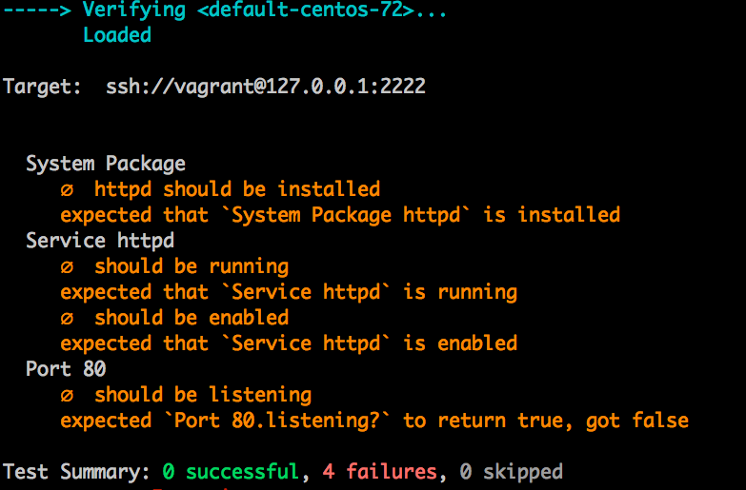
Integration Testing - Run the tests
Add a test
pass
Run the tests
fail
Make a little change
pass
[development continues]
fail
Run the tests
pass
[development stops]
Notes:
Static screen shot

Slide 22
Integration Testing – Make a change
package 'httpd' do
action :install
end
service 'httpd' do
action [ :start, :enable ]
end
Add a test
pass
Run the tests
fail
Make a little change
pass
[development continues]
fail
Run the tests
pass
[development stops]

Slide 23
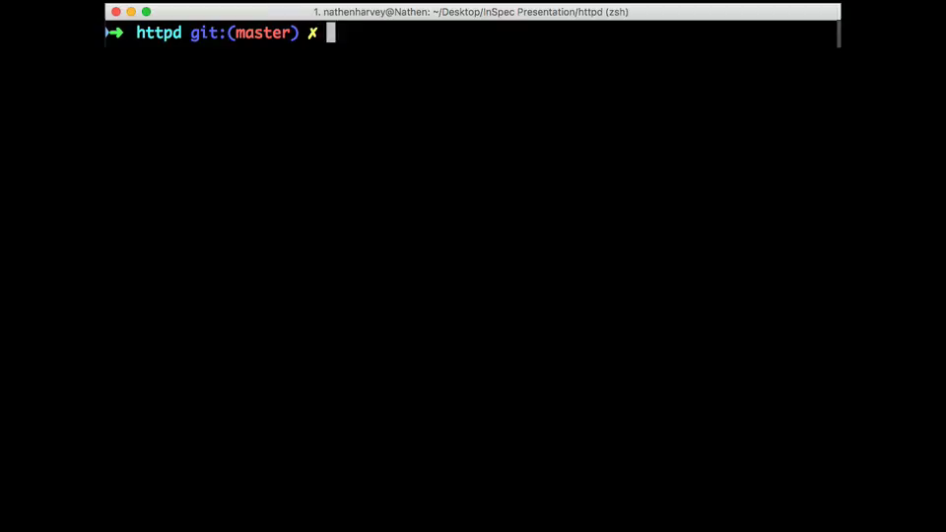
Integration Testing – Apply the change
Add a test
pass
Run the tests
fail
Make a little change
pass
[development continues]
fail
Run the tests
pass
[development stops]
Notes:
Auto-playing video

Slide 24
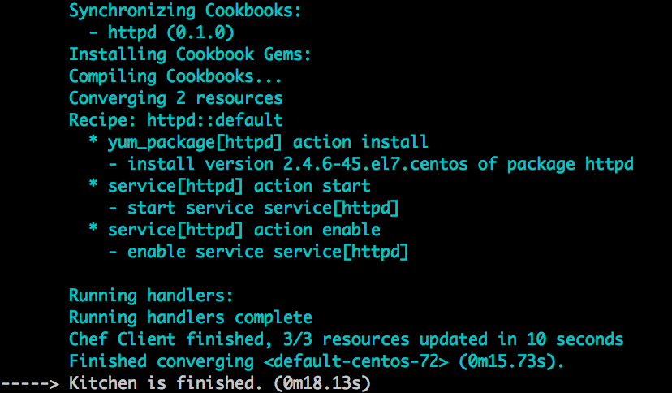
Integration Testing – Apply the change
Add a test
pass
Run the tests
fail
Make a little change
pass
[development continues]
fail
Run the tests
pass
[development stops]

Slide 25
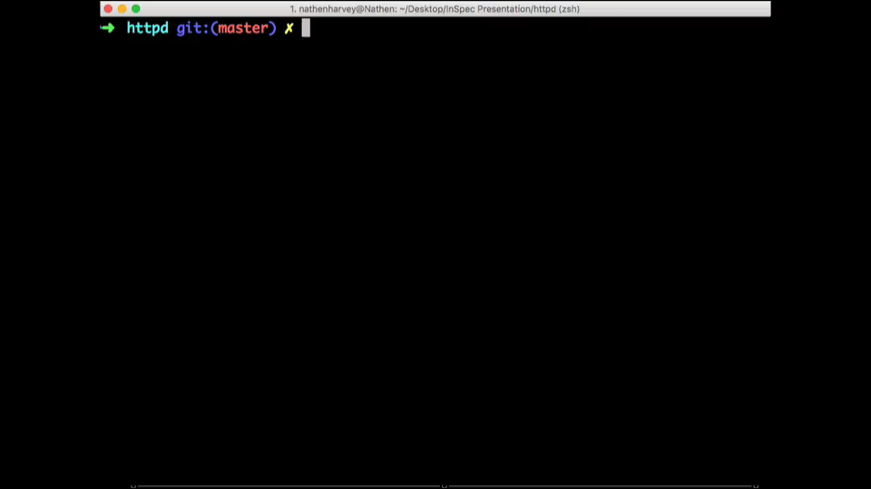
Integration Testing – Run the tests
Add a test
pass
Run the tests
fail
Make a little change
pass
[development continues]
fail
Run the tests
pass
[development stops]
Notes:
Auto-playing video

Slide 26
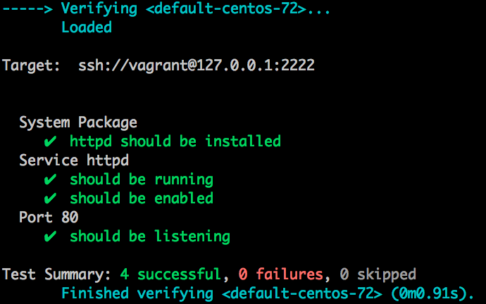
Integration Testing – Run the tests
Add a test
pass
Run the tests
fail
Make a little change
pass
[development continues]
fail
Run the tests
pass
[development stops]
Notes:
Static screen shot

Slide 27
InSpec
Compliance as Code

Slide 28

InSpec is compliance as code – a human-readable language for automating the continuous testing and compliance auditing of your entire infrastructure.

Slide 29
Compliance as Code
ACCELERATED CYCLE
ROLE OF THE COMPLIANCE OFFICER
Manual Compliance
Compliance at Velocity
Separate certification & testing
INFRASTRUCTURE
AS CODE
Common language for describing & applying policy
Reactive engagement
Proactive engagement
Checking implementations by hand
Expressing policy as testable code
POLICY
AS CODE
PRACTICE
AS CODE
Short term compliance
Long term process improvement
Compliance at velocity
One language, One workflow

Slide 30
SSH Control
SSH supports two different protocol versions. The original version, SSHv1, was subject to a number of security issues. Please use SSHv2 instead to avoid these.

Slide 31
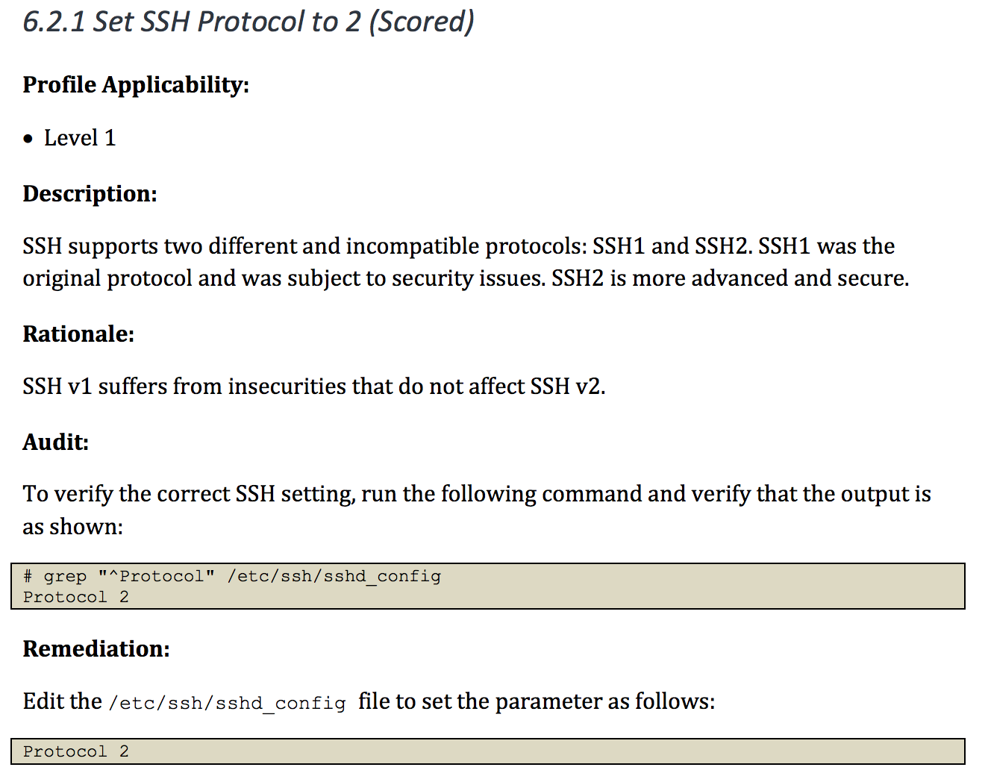
Mapping Compliance Document to InSpec
control 'ssh-6.2.1' do
title 'Set SSH Protocol to 2'
end

Slide 32
Mapping Compliance Document to InSpec
control 'ssh-6.2.1' do
title 'Set SSH Protocol to 2'
desc "
SSH supports two different ...
"
end

Slide 33
Mapping Compliance Document to InSpec
control 'ssh-6.2.1' do
title 'Set SSH Protocol to 2'
desc "
SSH supports two different ...
"
describe sshd_config do
its('Protocol') { should cmp('2') }
end
end

Slide 34
Mapping Compliance Document to InSpec
control 'ssh-6.2.1' do
impact 1.0
title 'Set SSH Protocol to 2'
desc "
SSH supports two different ...
"
describe sshd_config do
its('Protocol') { should cmp('2') }
end
end

Slide 35
Differences in verifying compliance policy
DOCUMENTATION
SSH supports two different protocol versions. The original version, SSHv1, was subject to a number of security issues. Please use SSHv2 instead to avoid these.
SCRIPTING TOOLS
COMPLIANCE LANGUAGE
> grep "^Protocol" /etc/ssh/sshd_config | sed 's/Protocol //'
2
control 'ssh-1234' do
impact 1.0
title 'Server: Set protocol version to SSHv2'
desc "
Set the SSH protocol version to 2. Don't use legacy
insecure SSHv1 connections anymore...
"
describe sshd_config do
its('Protocol') { should eq 2 }
end
end
COMPLIANCE LANGUAGE
describe sshd_config do
its('Protocol') { should eq 2 }
end

Slide 36





InSpec
ONE LANGUAGE
InSpec for Windows
control 'windows-base-201' do
impact 1.0
title 'Strong Windows NTLMv2 Authentication Enabled; Weak LM
Disabled'
desc '
@link: http://support.microsoft.com/en-us/kb/823659
'
describe registry_key
('HKLM\System\CurrentControlSet\Control\Lsa') do
it { should exist }
its('LmCompatibilityLevel') { should eq 4 }
end
end

Slide 37
InSpec
ONE LANGUAGE
Baremetal
VMs
Containers

Slide 38
Different ways to run InSpec
No ruby/agent on the node
No ruby/agent on the node
no SSH/agent in the container
Test your machine locally
> inspec exec test.rb
Test a machine remotely via SSH
> inspec exec test.rb -i identity.key -t ssh://root@172.17.0.1
Test a machine remotely via WinRM
> inspec exec test.rb -t winrm://Admin@192.168.1.2 --password super
Test Docker Container
> inspec exec test.rb -t docker://5cc8837bb6a8

Slide 39
InSpec
ONE LANGUAGE
Database Testing
Baremetal
VMs
Containers
Databases
API endpoints (e.g. cloud)
describe mysql_session.query("SELECT user,host FROM mysql.user WHERE host = '%'") do
its(:stdout) { should be empty }
end
Cloud Provider Testing
security_groups.each do |security_group|
describe security_group do
it { should_not have_inbound_rule().with_source('0.0.0.0/0') }
end
end

Slide 40



InSpec
ONE WORKFLOW
Security meets operations
COMPLIANCE
SECURITY
DEVOPS

Slide 41




InSpec
Each team uses separate tools
Unified language
COMPLIANCE
COMPLIANCE
SECURITY
DEVOPS
SECURITY
DEVOPS

Slide 42
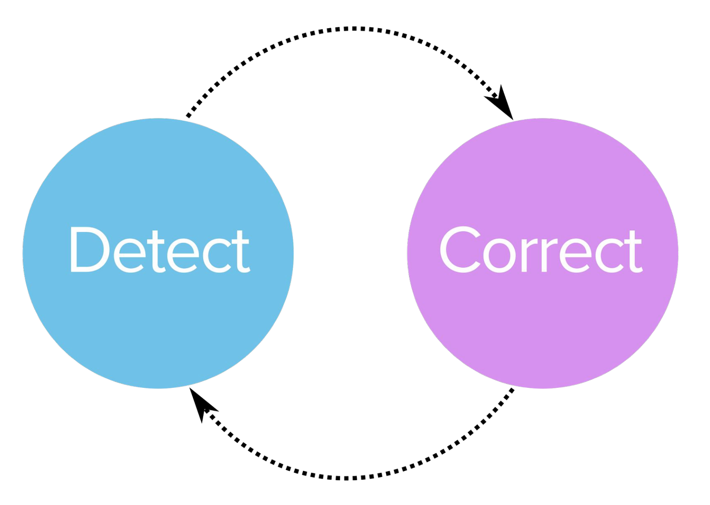
Continuous Workflow
Detect
Correct

Slide 43






InSpec
Turn security and compliance into code
PART OF A PROCESS OF CONTINUOUS COMPLIANCE
Translate compliance into Code
Clearly express statements of policy
Move risk to build/test from runtime
Find issues early
Write code quickly
Run code anywhere
Inspect machines, data, and APIs
Scan for Compliance
Build & Test Locally
Build & Test CI/CD
Remediate
Verify
A SIMPLE EXAMPLE OF AN INSPEC CIS RULE
control ‘cis-1.4.1’ do
title ‘1.4.1 Enable SELinux in /etc/grub.conf’
desc ‘
Do not disable SELinux and enforcing in your GRUB configuration. These are important security features that prevent attackers from escalating their access to your systems. For reference see …
‘
impact 1.0
expect(grub_conf.param ‘selinux’).to_not eq ‘0’
expect(grub_conf.param ‘enforcing’).to_not eq ‘0’
end

Slide 44
InSpec CLI
Command Line Interface

Slide 45
Objectives
Create and execute a simple compliance check

Slide 46
Ensure SSH Protocol is set to 2
Review the Center for Internet Security control
Create an InSpec profile to verify the control
Execute the InSpec profile to determine current system state

Slide 47

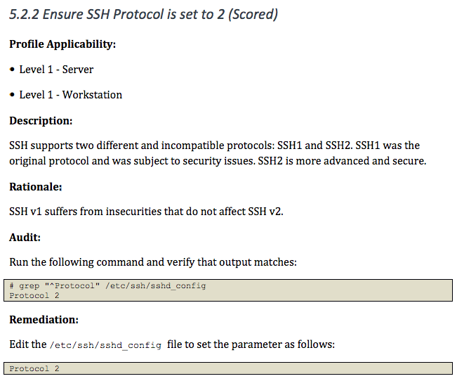
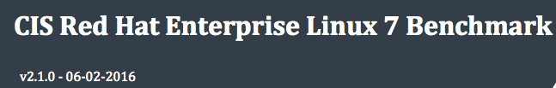
Compliance Mandate

Slide 48
Run InSpec
$ inspec
Commands:
inspec archive PATH # archive a profile to tar.gz (default) or zip
inspec artifact SUBCOMMAND ... # Sign, verify and install artifacts
inspec check PATH # verify all tests at the specified PATH
inspec compliance SUBCOMMAND ... # Chef Compliance commands
inspec detect # detect the target OS
inspec env # Output shell-appropriate completion configuration
inspec exec PATHS # run all test files at the specified PATH.
inspec help [COMMAND] # Describe available commands or one specific command
inspec init TEMPLATE ... # Scaffolds a new project
inspec json PATH # read all tests in PATH and generate a JSON summary
inspec shell # open an interactive debugging shell
inspec supermarket SUBCOMMAND ... # Supermarket commands
inspec vendor PATH # Download all dependencies and generate a lockfile in a `vendor` directory
inspec version # prints the version of this tool
Options:
l, [--log-level=LOG_LEVEL] # Set the log level: info (default), debug, warn, error
[--log-location=LOG_LOCATION] # Location to send diagnostic log messages to. (default: STDOUT or STDERR)
[--diagnose], [--no-diagnose] # Show diagnostics (versions, configurations)

Slide 49
Questions
What version of InSpec is installed?
What type(s) of projects with inspec init generate?

Slide 50
Build scaffold for an ssh profile
$ inspec init profile ssh
Create new profile at /home/ec2-user/ssh
* Create file README.md
* Create directory controls
* Create file controls/example.rb
* Create file inspec.yml
* Create directory libraries

Slide 51
Open the example control
/home/ec2-user/ssh/controls/example.rb
# encoding: utf-8
# copyright: 2015, The Authors
# license: All rights reserved
title 'sample section'
# you can also use plain tests
describe file('/tmp') do
it { should be_directory }
end
# you add controls here
control 'tmp-1.0' do # A unique ID for this control
impact 0.7 # The criticality, if this control fails.
title 'Create /tmp directory' # A human-readable title
desc 'An optional description...'
describe file('/tmp') do # The actual test
it { should be_directory }
end
end

Slide 52
Execute the example control
$ inspec exec ssh
Profile: InSpec Profile (ssh)
Version: 0.1.0
Target: local://
✔ tmp-1.0: Create /tmp directory
✔ File /tmp should be directory
File /tmp
✔ should be directory
Profile Summary: 1 successful, 0 failures, 0 skipped
Test Summary: 2 successful, 0 failures, 0 skipped

Slide 53
Rename the example control
$ mv ~/ssh/controls/example.rb ~/ssh/controls/server.rb

Slide 54
Rewrite the control
/home/ec2-user/ssh/controls/example.rb
# 5.2.2 Ensure SSH Protocol is set to 2
#
# grep "^Protocol" /etc/ssh/sshd_config
# Protocol 2
#
describe file('/etc/ssh/sshd_config') do
its('content') { should match /^Protocol 2/ }
end

Slide 55
Execute the control
$ inspec exec ssh
Profile: InSpec Profile (ssh)
Version: 0.1.0
Target: local://
File /etc/ssh/sshd_config
∅ content should match /^Protocol 2/
expected "# This config file was generated by Chef\n\n# $OpenBSD: sshd_config,v 1.93 2014/01/10 05:59:19...XMODIFIERS\n\n# override default of no subsystems\nSubsystem sftp /usr/libexec/openssh/sftp-server" to match /^Protocol 2/
Diff:
@@ -1,2 +1,78 @@
-/^Protocol 2/
+# This config file was generated by Chef
...
+Subsystem sftp /usr/libexec/openssh/sftp-server
Test Summary: 0 successful, 1 failures, 0 skipped

Slide 56
Wait a minute…
Where did its('content') come from?
What other file attributes can we write tests for?
Where does one go to find out more information about these resources?

Slide 57
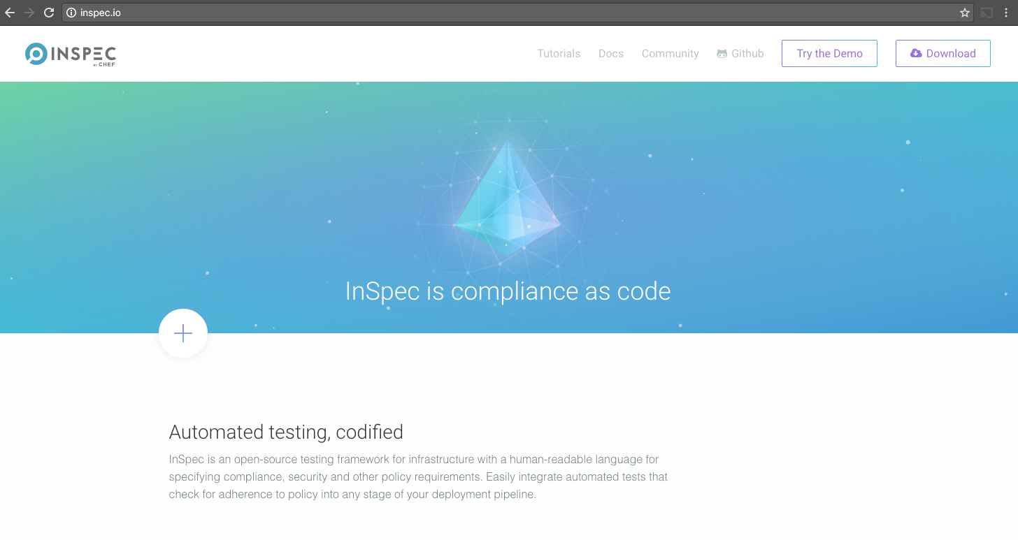

Slide 58
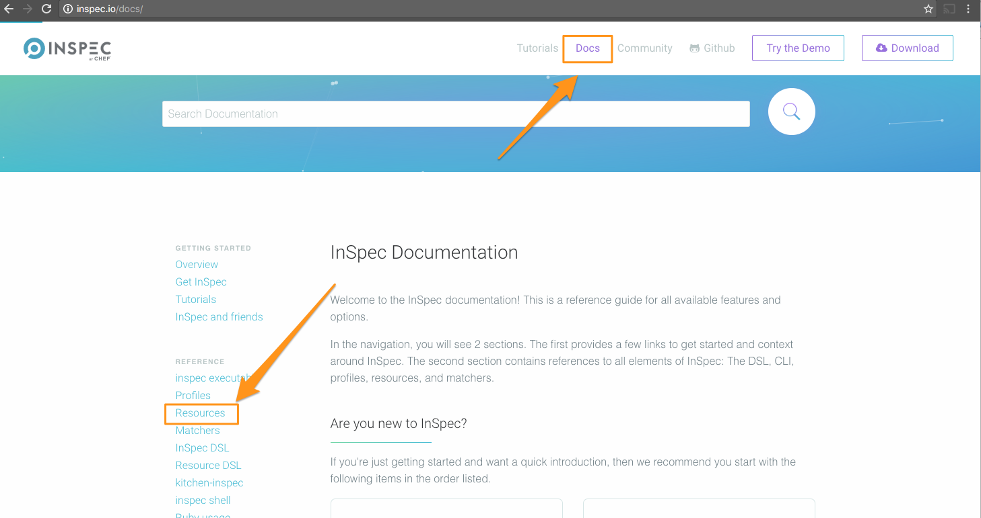

Slide 59
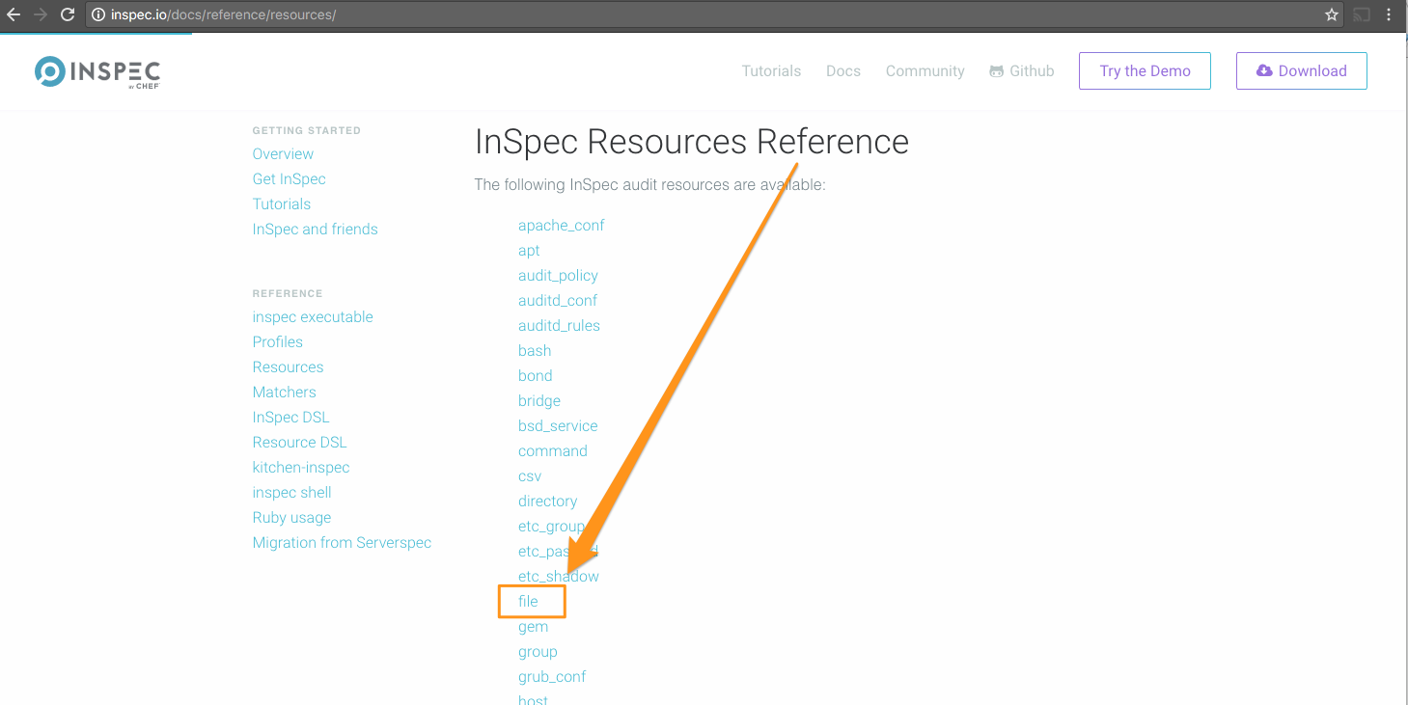

Slide 60
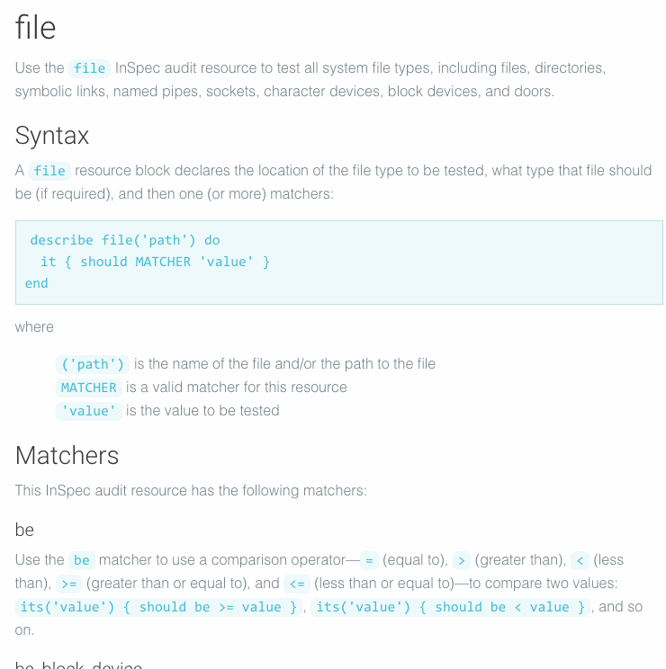

Slide 61
File Resource
describe file('path') do
it { should MATCHER 'value' }
end
Use the file resource to test all system file types, including files, directories, symbolic links, named pipes, sockets, character devices, block devices, and doors.

Slide 62
Test if a file exists
describe file('/tmp') do
it { should exist }
end

Slide 63
Test if a path is a directory
describe file('/tmp') do
its('type') { should eq :directory }
it { should be_directory }
end

Slide 64
Content Matcher
describe file('/etc/ssh/sshd_config') do
its('content') { should match /^Protocol 2/ }
end
The content matcher tests if contents in the file match the value specified in a regular expression. The values of the content matcher are arbitrary and depend on the file type being tested and also the type of information that is expected to be in that file

Slide 65
Ensure SSH Protocol is set to 2
Review the Center for Internet Security control
Create an InSpec profile to verify the control
Execute the InSpec profile to determine current system state

Slide 66
There are some problems!
Location of the SSH server configuration is hard-coded
Regular expressions are difficult

Slide 67
Refactor our control
Use a different resource

Slide 68
Which resource
Is there a better resource that we could use?
What might a refactored test look like?

Slide 69
Refactored Control
/home/ssh/controls/server.rb
describe sshd_config do
its('Protocol') { should cmp 2 }
end

Slide 70
Resource: sshd_config
describe sshd_config('path') do
its('name') { should include('foo') }
end
where
name is a configuration setting in sshd_config
('path') is the non-default /path/to/sshd_config
{ should include('foo') } tests the value of name as read from sshd_config versus the value declared in the test
Use the sshd_config resource to test configuration data for the OpenSSH daemon located at /etc/ssh/sshd_config on Linux and Unix platforms.

Slide 71
Execute the control
$ inspec exec ssh
SSH Configuration
∅ Protocol should cmp == 2
expected: 2
got:
(compared using `cmp` matcher)
Test Summary: 0 successful, 1 failures, 0 skipped

Slide 72
Refactor our control
Use a different resource

Slide 73
Execute profile on a remote machine
Execute your ssh profile against the instructor’s machine

Slide 74
Different ways to run InSpec
No ruby/agent on the node
No ruby/agent on the node
no SSH/agent in the container
Test your machine locally
> inspec exec test.rb
Test a machine remotely via SSH
> inspec exec test.rb -i identity.key -t ssh://root@172.17.0.1
Test a machine remotely via WinRM
> inspec exec test.rb -t winrm://Admin@192.168.1.2 --password super
Test Docker Container
> inspec exec test.rb -t docker://5cc8837bb6a8

Slide 75
Execute the control
$ inspec exec ssh -t ssh://ec2-35-156-226-39.eu-central-1.compute.amazonaws.com --user=chef --password=chef
SSH Configuration
∅ Protocol should cmp == 2
expected: 2
got:
(compared using `cmp` matcher)
Test Summary: 0 successful, 1 failures, 0 skipped

Slide 76
Execute profile on a remote machine
Execute your ssh profile against the instructor’s machine

Slide 77
Enrich our profile
Add additional metadata to our control

Slide 78
Compliance Mandate

Slide 79
Server Control
/home/ssh/controls/server.rb
describe sshd_config do
its('Protocol') { should cmp 2 }
end

Slide 80
Enriched Server Control
/home/ssh/controls/server.rb
control '5.2.2' do
impact 1.0
title 'Ensure SSH Protocol is set to 2'
desc <<-EOF
SSH supports two different and incompatible protocols: SSH1 and SSH2.
SSH1 was the original protocol and was subject to security issues.
SSH2 is more advanced and secure.
SSH v1 suffers from insecurities that do not affect SSH v2.
EOF
tag 'ssh', 'sshd', 'server', 'workstation'
ref 'SSH Protocol', url: 'https://access.redhat.com/documentation/en-US/Red_Hat_Enterprise_Linux/7/html/System_Administrators_Guide...'
describe sshd_config do
its('Protocol') { should cmp 2 }
end
end

Slide 81
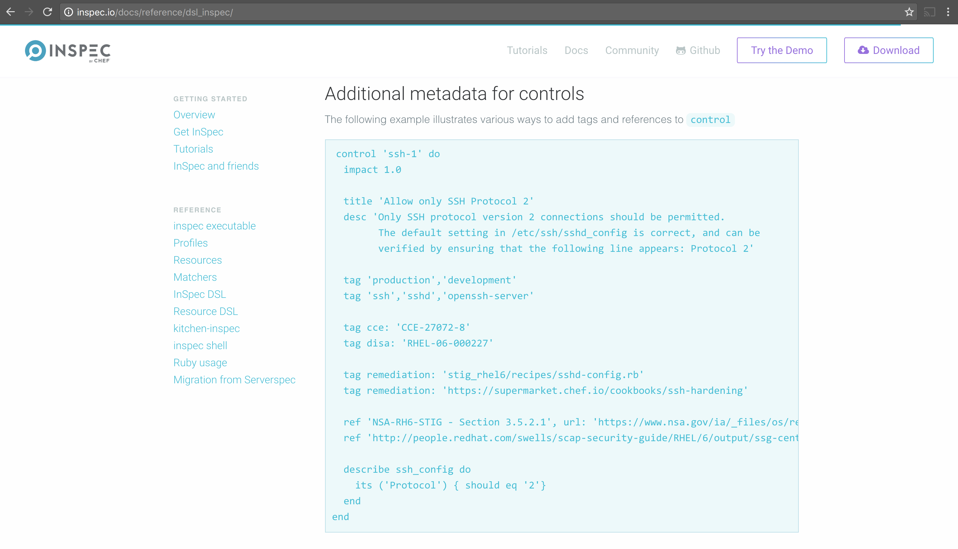

Slide 82
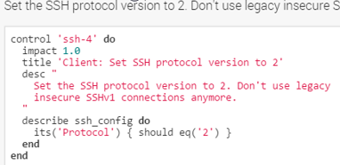
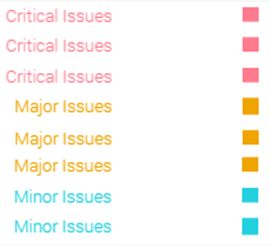
Compliance Profile Severity Mapping
The table below shows the current mapping of Compliance Profile impact numbering to severity.
Impact Numbering | Severity Designation
0.7 - 1.0 | Critical Issues
0.4 - <0.7 | Major Issues
0 - <0.4 | Minor Issues
https://nvd.nist.gov/cvss.cfm
Notes:
Here is the current mapping of Compliance Profile impact numbering to severity.
The image at the top-right shows a Compliance Profile's impact numbering.
The table at the bottom-left shows the current mapping of Compliance Profile impact numbering to severity.
The image at the bottom-right is an example of the severities listed in the reports in the Compliance web UI.
The mapping is currently analogous to the Common Vulnerability Scoring System (CVSS) framework, which can be viewed via the link at the bottom of this slide.
This mapping will be made configurable in the future.

Slide 83
Execute the control
$ inspec exec ssh
× 5.2.2: Ensure SSH Protocol is set to 2 (
expected: 2
got:
(compared using `cmp` matcher)
)
× SSH Configuration Protocol should cmp == 2
expected: 2
got:
(compared using `cmp` matcher)

Slide 84
Enrich our profile
Add additional metadata to our control

Slide 85
Objectives
Execute an InSpec test on a local machine
Execute an InSpec test on a remote machine
Generate an InSpec profile
Add InSpec-based integration test to a Chef cookbook
Run InSpec-based integrations tests during Chef cookbook development
List additional resources and places to look for support with InSpec

Slide 86
InSpec for Integration Testing

Slide 87
Simple Web Server Cookbook
The Apache web server should be running
The Apache web server should be listening on the default port
The Apache web server should be configured to start on boot

Slide 88
Create a directory for cookbooks
$ mkdir -p ~/cookbooks

Slide 89
Move into the directory for cookbooks
$ cd ~/cookbooks

Slide 90
Generate an apache cookbook
$ chef generate cookbook apache
Generating cookbook apache
- Ensuring correct cookbook file content
- Committing cookbook files to git
- Ensuring delivery configuration
- Ensuring correct delivery build cookbook content
- Adding delivery configuration to feature branch
- Adding build cookbook to feature branch
- Merging delivery content feature branch to master
Your cookbook is ready. Type `cd apache` to enter it.
There are several commands you can run to get started locally developing and testing your cookbook.
Type `delivery local --help` to see a full list.
Why not start by writing a test? Tests for the default recipe are stored at:
test/smoke/default/default_test.rb
If you'd prefer to dive right in, the default recipe can be found at:
recipes/default.rb

Slide 91
Move into the apache cookbook’s directory
$ cd ~/cookbooks/apache
Generating cookbook apache
- Ensuring correct cookbook file content
- Committing cookbook files to git
- Ensuring delivery configuration
- Ensuring correct delivery build cookbook content
- Adding delivery configuration to feature branch
- Adding build cookbook to feature branch
- Merging delivery content feature branch to master
Your cookbook is ready. Type `cd apache` to enter it.
There are several commands you can run to get started locally developing and testing your cookbook.
Type `delivery local --help` to see a full list.
Why not start by writing a test? Tests for the default recipe are stored at:
test/smoke/default/default_test.rb
If you'd prefer to dive right in, the default recipe can be found at:
recipes/default.rb

Slide 92
Remember…
Infrastructure policies need testing
↳ Linting
↳ Static Analysis
↳ Unit Testing
↳ Integration Testing ↳ Compliance Testing
“Infrastructure as Code” should be tested like ANY other codebase.
Notes:
We will be focused on Integration Testing for now

Slide 93
Remember…
Infrastructure policies need testing
↳ Linting
↳ Static Analysis
↳ Unit Testing
↳ Integration Testing ↳ Compliance Testing
“Infrastructure as Code” should be tested like ANY other codebase.
Notes:
We will be focused on Integration Testing for now

Slide 94
Test-driven Development
Write a test, watch it fail
Write some code
Write and run more tests
Code review
Delivery pipeline to production
Lowered chance of production failure
Add a test
pass
Run the tests
fail
Make a little change
pass
[development continues]
fail
Run the tests
pass
[development stops]

Slide 95
Software Testing and Why it Matters
more time
more time
manual
tests
automated
API tests
automated
GUI tests
automated unit tests
automated
integration tests
integration
tests
less time
less time
automated
GUI tests
unit
tests
manual session based tests
automated
component tests
quantity
quantity
Testing builds safety through feedback loops
Inexpensive experiments to provide validation
Reduces risk
Optimize Testing: Do more of the inexpensive testing first!

Slide 96
What can delivery local do?
$ delivery local --help
delivery-local
Run Delivery phases on your local workstation.
USAGE:
delivery local [FLAGS] <phase>
FLAGS:
-h, --help Prints help information
--no-spinner Disable the spinner
--non-interactive Disable cli interactions
-V, --version Prints version information
ARGS:
<phase> Delivery phase to execute [values: unit, lint, syntax, provision, deploy, smoke, cleanup]

Slide 97
Test Kitchen
Delivery
kitchen list
kitchen create
kitchen converge
kitchen verify
kitchen destroy
kitchen test
kitchen login
[No matching delivery command]
delivery local provision
delivery local deploy
delivery local smoke
delivery local cleanup
[No matching delivery command]
[No matching delivery command]
~/cookbooks/apache/.delivery/project.toml

Slide 98
Update the Kitchen Configuration
~/cookbooks/apache/.kitchen.yml
---
driver:
name: vagrant
name: docker
use_sudo: false

Slide 99
Update the Kitchen Configuration
~/cookbooks/apache/.kitchen.yml
platforms:
- name: ubuntu-16.04
- name: centos-7.2
- name: centos-6.8

Slide 100
Final .kitchen.yml
~/cookbooks/apache/.kitchen.yml
---
driver:
name: docker
use_sudo: false
provisioner:
name: chef_zero
# You may wish to disable always updating cookbooks in CI or other testing environments.
# For example:
# always_update_cookbooks: <%= !ENV['CI'] %>
always_update_cookbooks: true
verifier:
name: inspec
platforms:
- name: centos-6.8
suites:
- name: default
run_list:
- recipe[apache::default]
verifier:
inspec_tests:
- test/smoke/default
attributes:

Slide 101
List Kitchen Instances
$ kitchen list
Instance Driver Provisioner Verifier Transport Last Action Last Error
default-centos-68 Docker ChefZero Inspec Ssh <Not Created> <None>

Slide 102
Run the integration tests
$ delivery local smoke
Chef Delivery
Running Smoke Phase
-----> Starting Kitchen (v1.14.2)
-----> Creating <default-centos-68>...
Sending build context to Docker daemon 193.5 kB
Step 1 : FROM centos:centos7
...
-----> Verifying <default-centos-68>...
Loaded
Target: ssh://kitchen@localhost:32768
User root
✔ should exist
↺ This is an example test, replace with your own test.
Port 80
✔ should not be listening
↺ This is an example test, replace with your own test.
Test Summary: 2 successful, 0 failures, 2 skipped
Finished verifying <default-centos-68> (0m0.45s).
-----> Kitchen is finished. (1m4.44s)

Slide 103
Integration Testing – Add tests
describe package 'httpd' do
it { should be_installed }
end
describe service 'httpd' do
it { should be_running }
it { should be_enabled }
end
describe port(80) do
it { should be_listening }
end
Add a test
pass
Run the tests
fail
Make a little change
pass
[development continues]
fail
Run the tests
pass
[development stops]

Slide 104
Resource: package
describe package('name') do
it { should be_installed }
end
where
('name') must specify the name of a package, such as 'nginx'
be_installed is a valid matcher for this resource
Use the package resource to test if the named package and/or package version is installed on the system.

Slide 105
Resource: service
describe service('service_name') do
it { should be_installed }
it { should be_enabled }
it { should be_running }
end
Use the service resource to test if the named service is installed, running and/or enabled.

Slide 106
Resource: port
describe port(514) do
it { should be_listening }
end
Use the port InSpec audit resource to test basic port properties, such as port, process, if it’s listening.

Slide 107
Run the Integration Test
$ delivery local smoke
System Package
∅ httpd should be installed
expected that `System Package httpd` is installed
Service httpd
∅ should be running
expected that `Service httpd` is running
∅ should be enabled
expected that `Service httpd` is enabled
Port 80
∅ should be listening
expected `Port 80.listening?` to return true, got false
Test Summary: 0 successful, 4 failures, 0 skipped

Slide 108
Integration Testing – Make a change
package 'httpd' do
action :install
end
service 'httpd' do
action [ :start, :enable ]
end
Add a test
pass
Run the tests
fail
Make a little change
pass
[development continues]
fail
Run the tests
pass
[development stops]

Slide 109
Apply the change
$ delivery local deploy
Chef Delivery
Running Deploy Phase
-----> Starting Kitchen (v1.14.2)
-----> Converging <default-centos-68>...
Preparing files for transfer
Preparing dna.json
Resolving cookbook dependencies with Berkshelf 5.2.0...
...
Recipe: apache::default
* yum_package[httpd] action install
- install version 2.2.15-56.el6.centos.3 of package httpd
* service[httpd] action start
- start service service[httpd]
* service[httpd] action enable
- enable service service[httpd]
Running handlers:
Running handlers complete
Chef Client finished, 3/3 resources updated in 06 seconds
Finished converging <default-centos-68> (0m11.54s).
-----> Kitchen is finished. (0m12.42s)

Slide 110
Run the Integration Test
$ delivery local smoke
System Package
✔ httpd should be installed
Service httpd
✔ should be running
✔ should be enabled
Port 80
✔ should be listening
Test Summary: 4 successful, 0 failures, 0 skipped
Finished verifying <default-centos-68> (0m0.58s).
-----> Kitchen is finished. (0m1.46s)

Slide 111
Integration Testing – Run the tests
Add a test
pass
Run the tests
fail
Make a little change
pass
[development continues]
fail
Run the tests
pass
[development stops]
Notes:
Static screen shot

Slide 112
Simple Web Server Cookbook
The Apache web server should be running
The Apache web server should be listening on the default port
The Apache web server should be configured to start on boot

Slide 113
Software Testing and Why it Matters
more time
more time
manual
tests
automated
API tests
automated
GUI tests
automated unit tests
automated
integration tests
integration
tests
less time
less time
automated
GUI tests
unit
tests
manual session based tests
automated
component tests
quantity
quantity
Testing builds safety through feedback loops
Inexpensive experiments to provide validation
Reduces risk
Optimize Testing: Do more of the inexpensive testing first!

Slide 114
Additional Testing
What command would you use to complete lint testing?
What command would you use to complete syntax testing?
What command would you run to complete unit tests?
What additional kitchen-related commands should we run?
How would you InSpec exec your tests over the docker protocol?
Notes:
runner = ChefSpec::ServerRunner.new(:platform => 'centos', :version => '6.8')
inspec exec ssh -t docker://65280217fe65

Slide 115
Objectives
Execute an InSpec test on a local machine
Execute an InSpec test on a remote machine
Generate an InSpec profile
Add InSpec-based integration test to a Chef cookbook
Run InSpec-based integrations tests during Chef cookbook development
List additional resources and places to look for support with InSpec

Slide 116
Further Resources
Where to go for additional help

Slide 117
Community Resources
InSpec Website, includes tutorials and docs - http://inspec.io/
#inspec channel of the Chef Community Slack - http://community-slack.chef.io/
InSpec category of the Chef Mailing List - https://discourse.chef.io/c/inspec
Compliance Profiles on the Supermarket - https://supermarket.chef.io/tools?type=compliance_profile
Open Source Project - https://github.com/chef/inspec

Slide 118



DAY 1 // MAY 22
DAY 2 // MAY 23
DAY 3 // MAY 24
DAY 4 // MAY 25
Workshops & Chef Training
DevOps Leadership Summit
Community Summit
Partner Summit
Welcome Reception
Customer Dinner
Analyst Day
Keynotes
Technical Sessions
Happy Hour
Game Night
Executive Dinner
Keynotes
Technical Sessions
Awesome Chef Awards
Community Celebration
Hackday
• Exhibit Hall Open & Sales suites available • chefconf.chef.io •
Notes:
Texas, austin, bathroom law

Slide 119


Slide 120
Objectives
Execute an InSpec test on a local machine
Execute an InSpec test on a remote machine
Generate an InSpec profile
Add InSpec-based integration test to a Chef cookbook
Run InSpec-based integrations tests during Chef cookbook development
List additional resources and places to look for support with InSpec

Slide 121
More hands-on Exercises
Still have time to play around?

Slide 122
Remediate ssh Protocol
Write a cookbook to manage ssh
Verify the Protocol is set appropriately
Apply the recipe to your local machine with chef-client --local (if you dare!)
Verify your colleague’s work

Slide 123
Build additional CIS controls
https://github.com/chef-training/workshops/tree/master/InSpec

Slide 124
Supermarket Profiles
List profiles available on the Supermarket
View information about the dev-sec/ssh-baseline profile
Execute the dev-sec/ssh-baseline profile from the Supermarket
Write a cookbook to remediate failing controls from dev-sec/ssh-baseline

Slide 125
Unit Testing
Add unit testing to our apache cookbook
Create a cookbook to remediate the failing ssh controls; include unit tests

Slide 126
Introduction to InSpec
Notes:
This Chef Compliance course provides an understanding of the capabilities of Chef Compliance. This course covers how to install and initially configure the Chef Compliance server, perform compliance scans against Windows and Linux nodes, and remediate compliance issues with Chef, and run Compliance reports.
In addition, you will learn how to use InSpec to create and modify Chef Compliance profiles and learn how to locate CIS (Center for Internet Security) and DoD (Department of Defense) compliance specifications that you can use to write Chef Compliance profiles.
Instructor Note: Be sure to read Appendix Z at the end of this instructor guide for training lab set up notes and additional instructor notes. Instructor Note: This course has been tested on Compliance Server v1.2.4. The labs have been tested against target Linux and Windows nodes that have ChefDK 0.11.2 and inspec 0.14.7. You must use at least inspec 0.14.7 on the target nodes in order for these labs to work. That version of inspec is present on the AMIs used for this course. Update: The Linux AMI has been upgraded to inspec 0.22.1 so that CLI login to Compliance Sever will work, as documented in module 05-Creating Custom Profiles.

